Slide 1
Navigating Limited Submission Opportunities for External Funding at
UW-Madison
Steve Flaherty, Divisional Research Administrator, OVCR
Amber Jensen, Divisional Research Administrator, OVCR
Nick Novak, Assistant Dean for Research Services, OVCR

Slide 2
Outline
What are limited submissions?
How to spot them
Examples
Who manages?
Process
Submission criteria
How to submit
Review process
Notifications
Next steps
More examples
Best practices

Slide 3

What are limited submissions?
A Limited Submission is a funding opportunity for which the sponsor sets an institutional limit for the number of proposals it will accept.
Why do sponsors limit?

Slide 4

How to spot them
Check “Eligibility” section of solicitation
Common Examples
Sometimes it’s not obvious

Slide 5
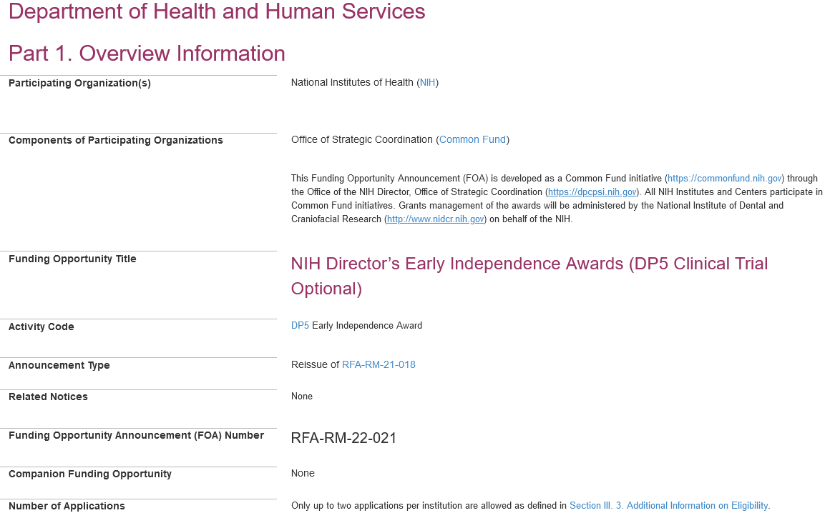
Eligibility example - NIH

Slide 6

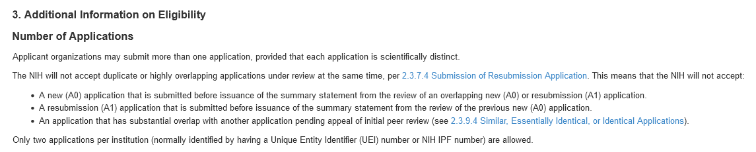
Eligibility example - NIH

Slide 7
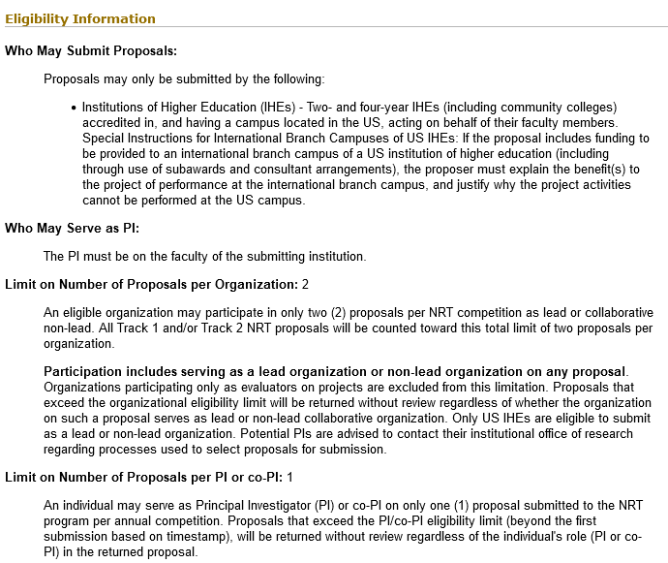
Eligibility example - NSF

Slide 8
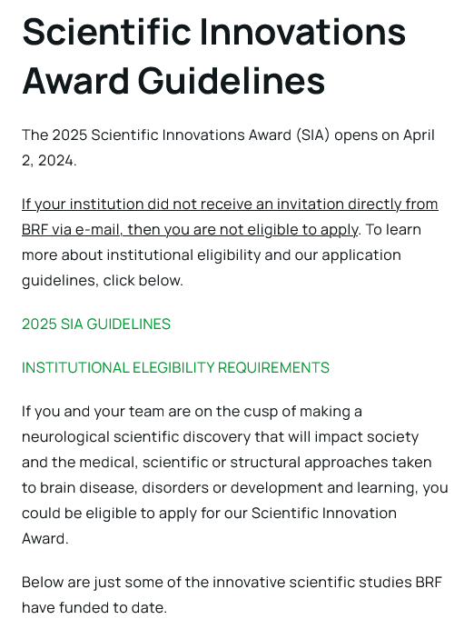
Eligibility example - Invited

Slide 9
Eligibility example - Invited
Brain Research Foundation
2024 Scientific Innovations Award
Grant Announcement
Brain Research Foundation is inviting your institution to nominate one senior faculty member to submit a Letter of Intent for the 2024 Scientific Innovations Award (SIA). The objective of the program is to support projects that may be too innovative and speculative for traditional funding sources but still have a high likelihood of producing important findings. It is expected that investigations supported by these grants will yield high impact findings and result in major grant applications and funding as well as significant publications in high impact journals.

Slide 10
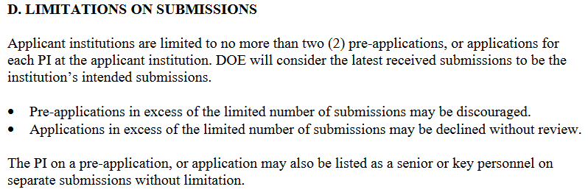
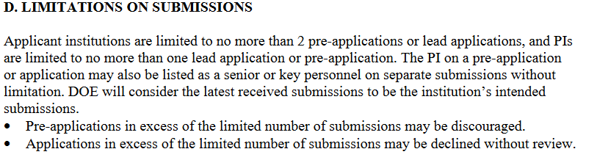
Eligibility examples - Other

Slide 11
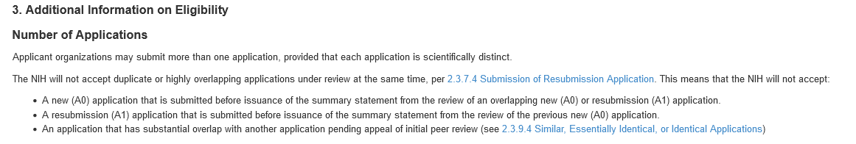
What are not limited submissions
NIH language on each proposal needing to be unique
One per PI is not limited

Slide 12
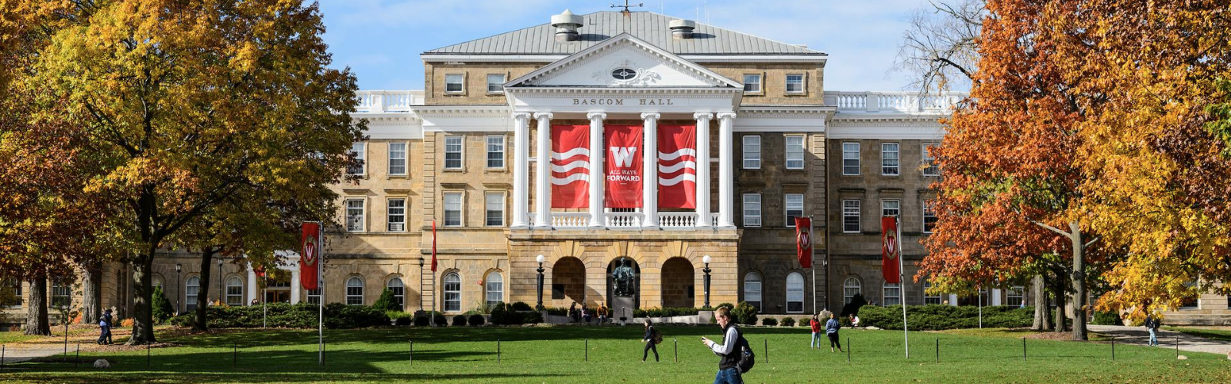
Who manages these at UW-Madison?
OVCR
Exceptions:
  When anticipated applications are from one school/college or department
  Hartwell Foundation, Lily’s Fund
AVCs decide on who manages

Slide 13

Process

Slide 14
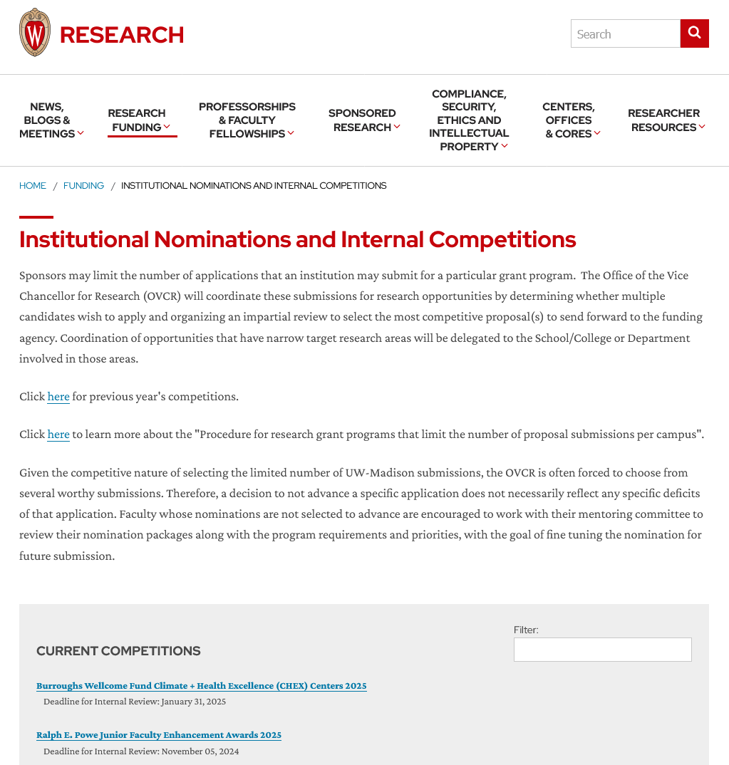
Process
OVCR Internal Competitions Website:

Slide 15

Process

Slide 16

Process

Slide 17
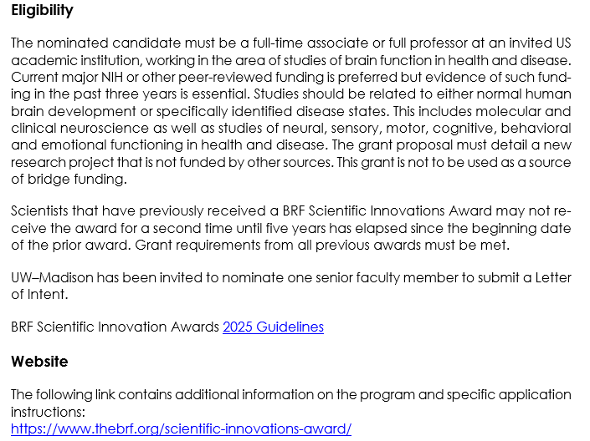
Process

Slide 18
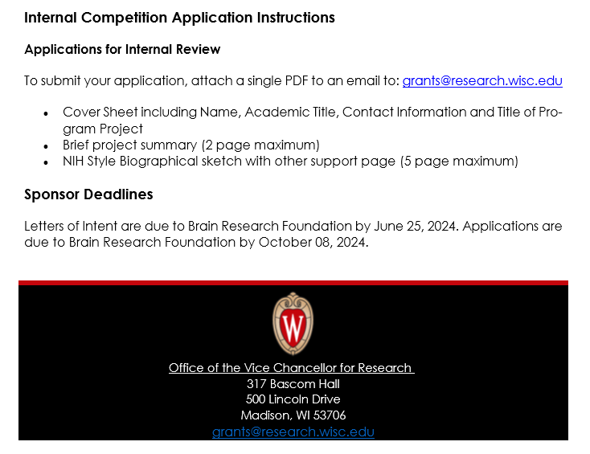
Process

Slide 19

General internal submission criteria
Cover Page
CV or Biosketch
Research Project Summary
Other – Letter of support, Professional Service and Diversity, Equity, and Inclusion Statement, etc.

Slide 20
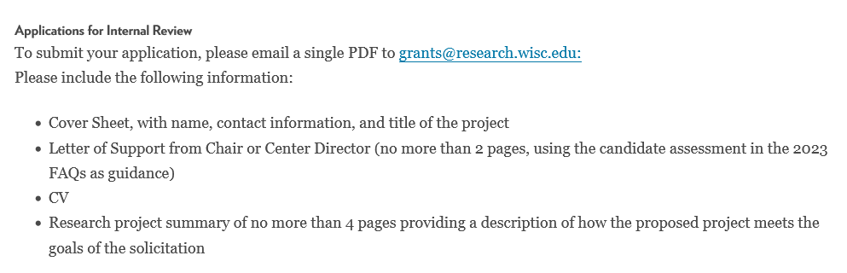
How to submit internal competition materials
Email us (for now)!

Slide 21
Review process
Associate Vice Chancellors at OVCR
Dean, Associate Deans in the Graduate School
Experts in particular area of science
Past awardees
Timeline for review

Slide 22

Notifications
Email those selected and not selected.
For those selected, copy department research administrator and division.
May include others such as mentor or chair.

Slide 23
Next steps
Researcher works with department and division to submit application as they normally would.
Attach OVCR approval to RAMP record.
Some opportunities require OVCR to submit a nomination or submit entire proposal. Blavatnik Awards, Moore Inventor Fellowship, Pew Scholars Program. Still route a RAMP record.
We’ll let you know!

Slide 24

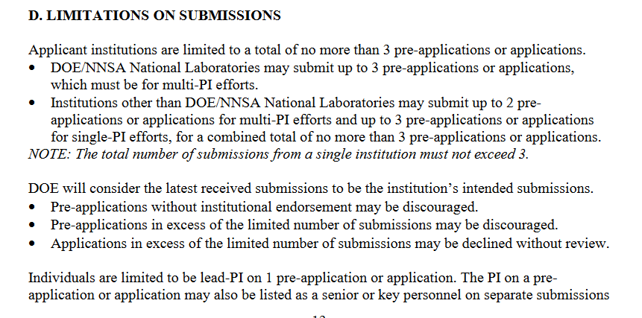
Example competitions – Quick turnaround

Slide 25
Example competitions – Quick turnaround

Slide 26
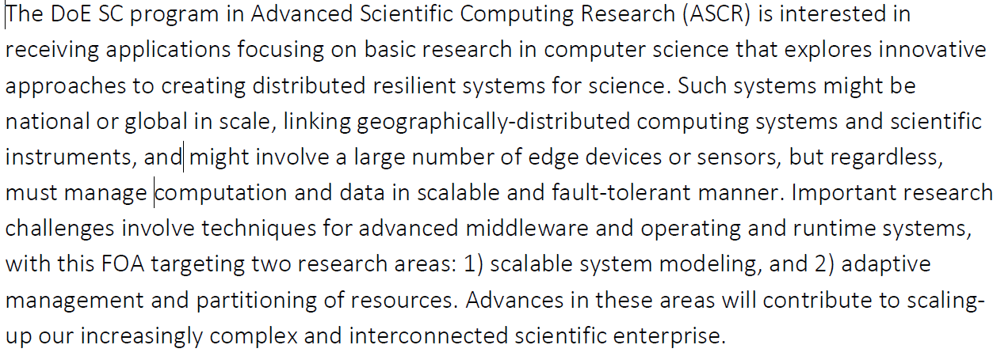
Example competitions – Quick turnaround

Slide 27
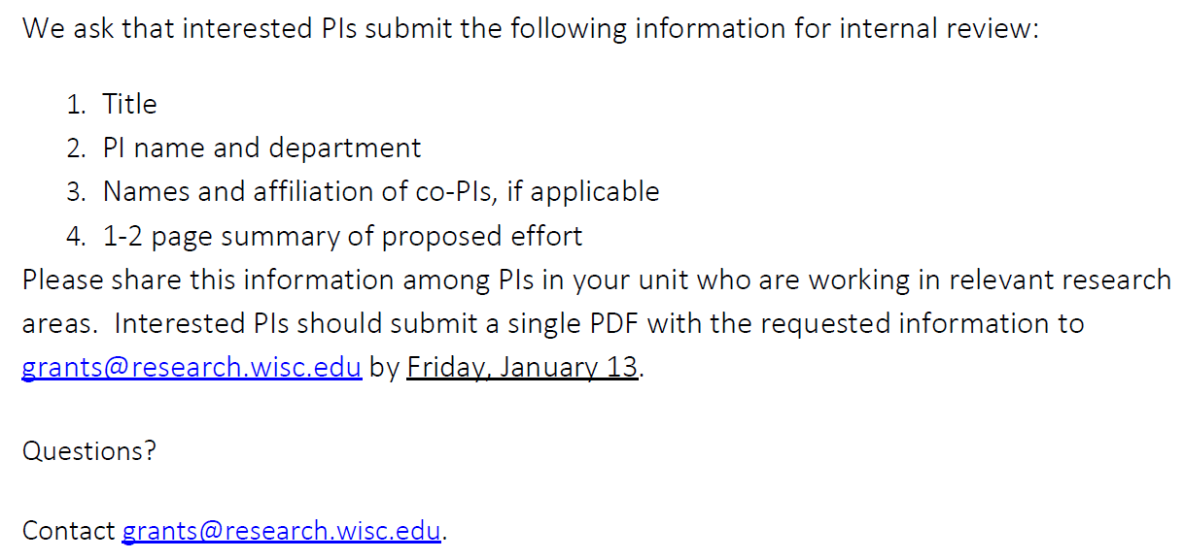
Example competitions – Quick turnaround

Slide 28
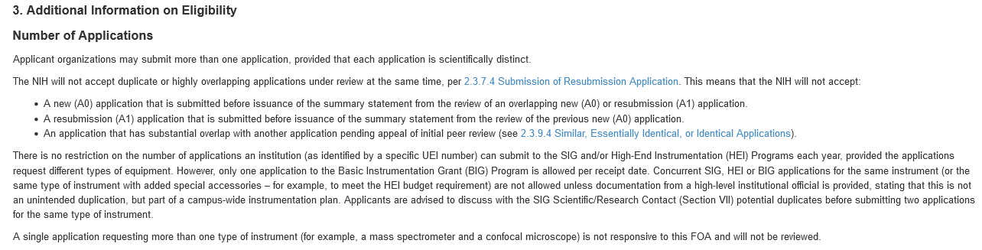
Example competitions – Not Limited
NIH S10: Shared Instrumentation Grant (SIG) and High-End Instrumentation Grant Program (HEI)

Slide 29
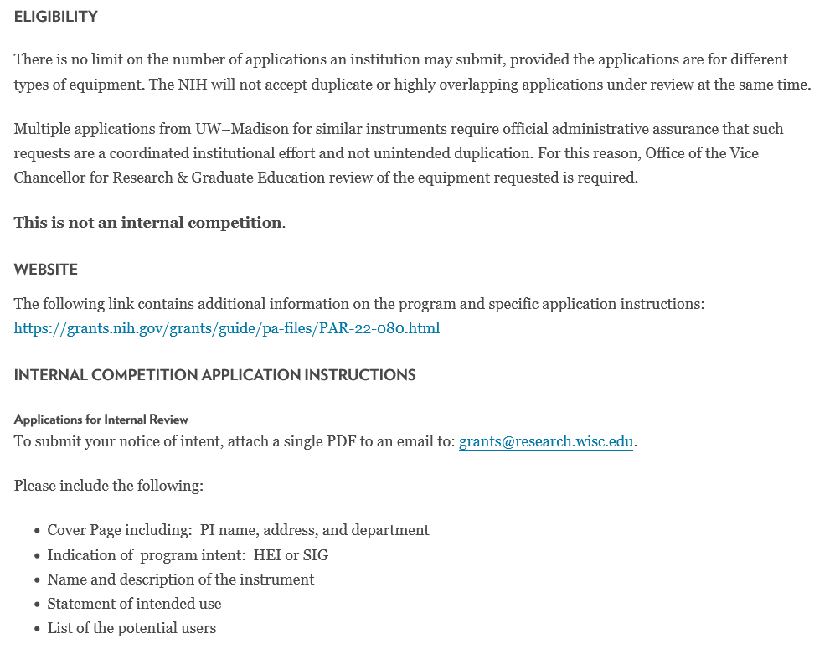
Example competitions – Not Limited

Slide 30
Best Practices
Review Eligibility Section
Check our website for competitions and procedure
Distribute our emails to researchers
Attach OVCR email confirmation to RAMP record
Contact us for guidance grants@research.wisc.edu

Slide 31

Questions
https://research.wisc.edu/funding/institutional-nominations/
Thank you!

